Slide 1
Software Development LifeCycle
SASKEN TECHNOLOGY LTD, Bangalore
SUBMITED TO:-
Mr. Shrinath Inamdar (Project Manager)
PRESENTED BY:-
Divya (210668)
kajal (210681)
Rakesh T (210679)
Prakash Kumar (210673)

Slide 2
OUTLINES:
Introduction
Waterfall model
Iterative model
Spiral model
V-Model
Big Bang Model
Agile Model
RAD Model
Software Prototype
Conclusion

Slide 3
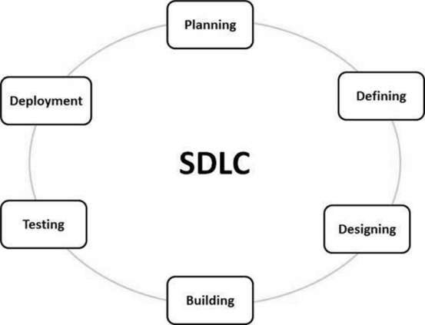
INTRODUCTION
GRAPHICAL REPRESENTATION
Software Development Life Cycle (SDLC) is a process used by the software industry to design, develop and test high quality software.
It is like a framework that defines tasks which has to be performed at each step in software development process.
The main aim is to produce a high-quality software that can fulfill the customer expectations and can be completed within time.
It also helps cost estimates of product.

Slide 4
WATERFALL MODEL
It was first process model to be introduced.
It is also known as Linear- sequential life cycle Model.
Waterfall model is very simple as it follow sequential structure.
In this model, the whole process of software development is divided into separate phases and each phase must be completed before moving to the next phase.
There is no overlapping in the phases.
waterfall model is very earliest SDLC approach for software development .

Slide 5
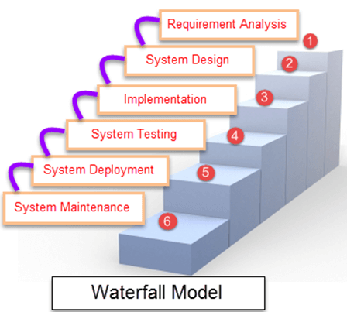
GRAPHICAL REPRESENTATION
WHERE CAN WE USE ?
Different Software need different approach to develop it. Following are some situation where waterfall model is suitable :-
Requirements are very well documented, clear and fixed.
Product definition is stable i.e. static.
Technology is understood and is not dynamic.
There are no ambiguous requirements.
Ample resources with required expertise are available to
support the product. And product should be short.

Slide 6
ADVANTAGE OF WATERFALL MODEL
Simple and easy to understand and use.
Easy to manage due to the rigidity of the model.
Phases are processed and completed one at a time.
Works well for smaller projects where requirements are very well understood.
Stages and milestones are clearly defined.
Process and results are well documented.
DISADVANTAGE OF WATERFALL MODEL
High amounts of risk and uncertainty.
No working software is produced until late during the life cycle.
Not a good model for complex and object-oriented projects.
Cannot accommodate changing requirements.
Cannot accommodate changing if required.

Slide 7
ITERATIVE MODEL
In the Iterative model, iterative process for the development of software starts with a simple implementation of a small set of the software requirements.
This model iteratively enhances the evolving versions until the complete system is implemented and ready to be deployed.
An iterative life cycle model does not attempt to start with a full specification of requirements.
Development begins by specifying and implementing just part of the software, which is then reviewed to identify further requirements.
This process is then repeated, producing a new version of the software at the end of each iteration of the model.

Slide 8
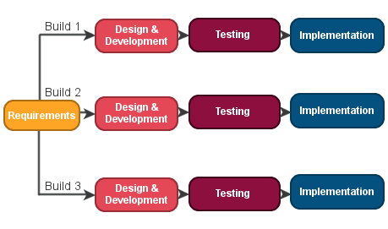
GRAPHICAL REPRESENTATION
WHERE WE CAN USE ?
Requirements of the complete system
are clearly defined and understood.
Major requirements must be defined;
however, some functionalities or
requested enhancements may evolve
with time.
There is a time to the market constraint.
There are some high-risk features and goals which may change in the future.

Slide 9
ADVANTAGE OF ITERATIVE MODEL
Some working functionality can be developed quickly and early in the life cycle.
Results are obtained early and periodically.
Less costly to change the scope/requirements.
Easier to manage risk - High risk part is done first.
DISADVANTAGE OF ITERATIVE MODEL
More resources may be required for further enhancement.
Although cost of change is lesser, but it is not very suitable for changing requirements.
More management attention is required.
Defining increments may require definition of the complete system.

Slide 10
SPIRAL MODEL
Spiral model is a combination of iterative development process model and sequential linear development model i.e. the waterfall model.
It allows more refinement in the product through each iteration around the spiral.
The spiral model has four phases. A software project repeatedly passes through these phases in iterations called Spirals.
This phase starts with gathering the business requirements in the baseline spiral.
As the product matures and communication between the customer and the system analyst get satisfied the product is deployed in the identified market at the end of spiral.

Slide 11
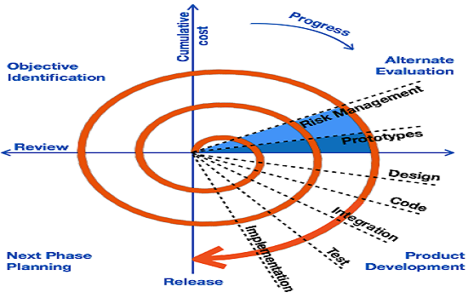
GRAPHICAL REPRESENTATION
Usage of Spiral
When there is a budget constraint and risk evaluation is important.
For medium to high-risk projects.
Customer is not sure of their requirements which is usually the case.
New product line which should be released in phases to get enough customer feedback.
Significant changes are expected in the product during the development cycle.

Slide 12
ADVANTAGE OF SPIRAL MODEL
Changing requirements can be accommodated.
Allows extensive use of prototypes.
Users see the system early.
Development can be divided into smaller parts and the risky parts can be developed earlier which helps in better risk management.
DISADVANTAGE OF SPIRAL MODEL
Management is more complex.
Not suitable for small or low risk projects and could be expensive for small projects.
Spiral may go on indefinitely.
Large number of intermediate stages requires excessive documentation.

Slide 13
V-MODEL
The V-model is also known as Verification and Validation model.
In this SDLC model execution of processes happens in a sequential manner in a V-shape.
Each development stage in v-model pass with the testing phase.
This is a highly-disciplined model and the next phase starts only after completion and testing of the previous phase.
This model is associate with the testing phase, so there are Verification phases on one side of the ‘V’ and Validation phases on the other side.

Slide 14
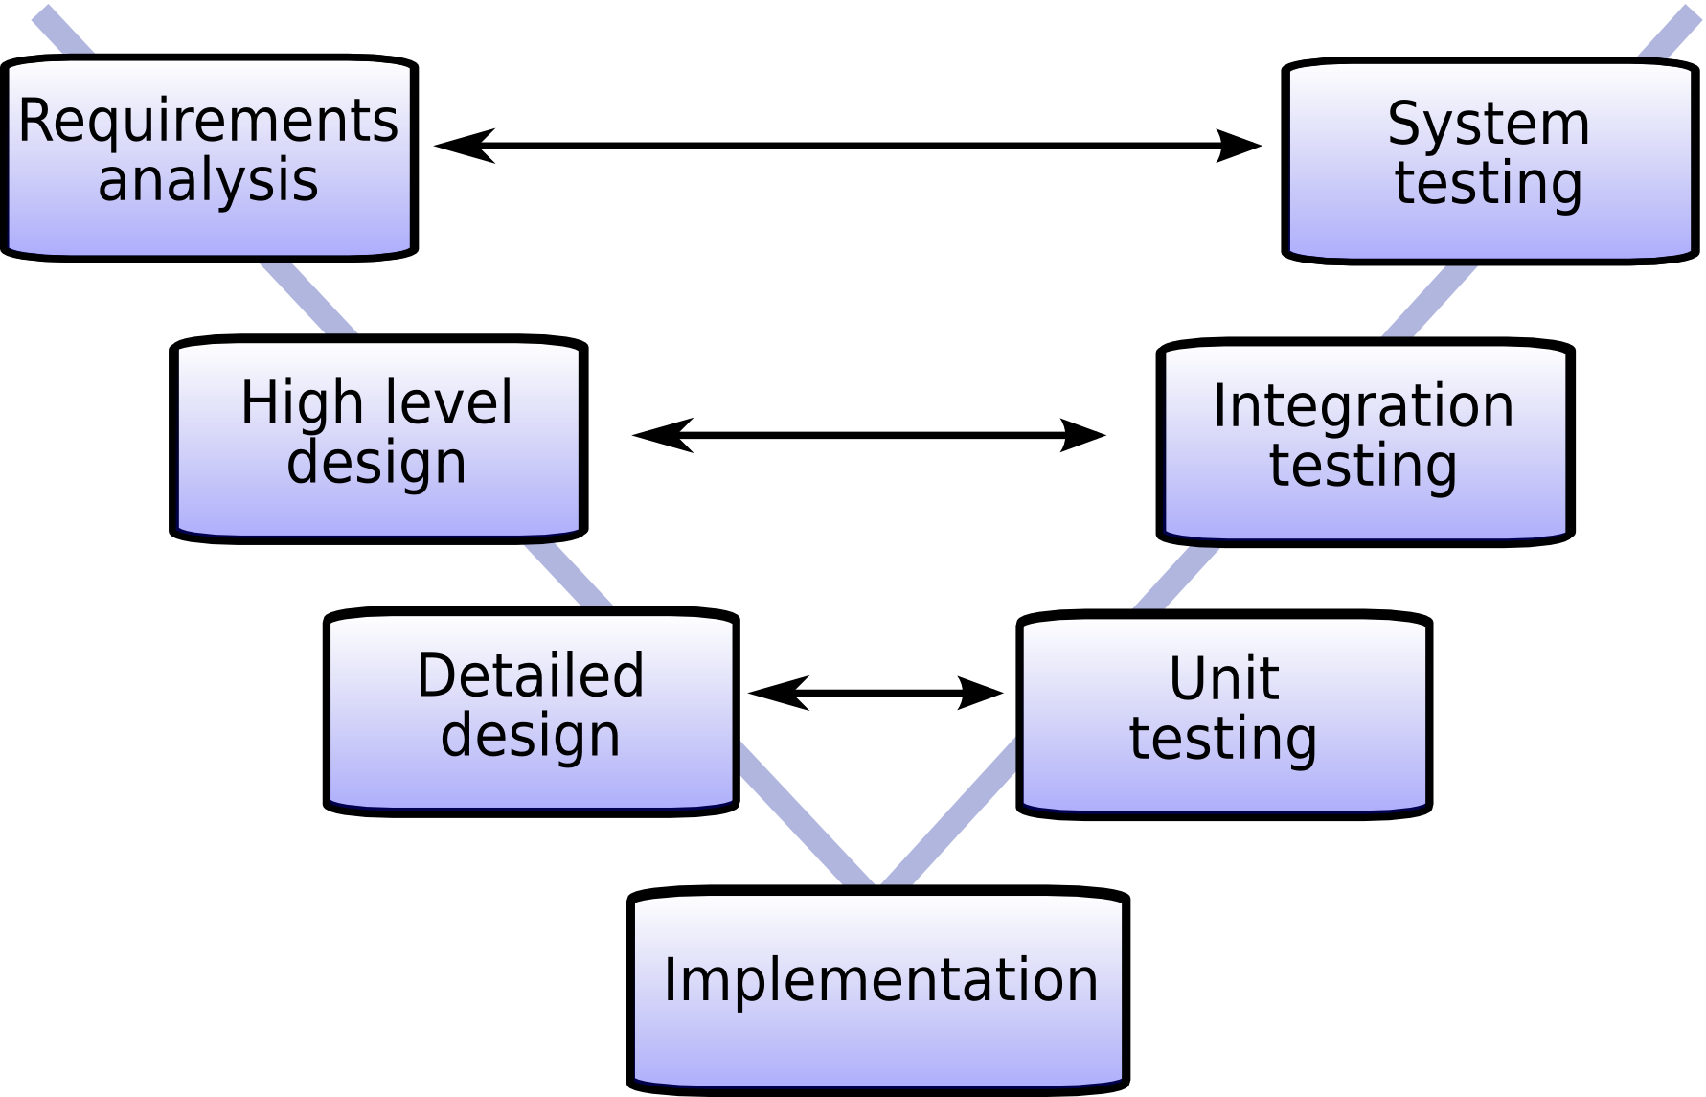
GRAPHICAL REPRESENTATION
WHERE CAN WE USE ?
Requirements are well defined, clearly documented and fixed.
Product definition is stable.
Technology is not dynamic and is well understood by the project team.
There are no ambiguous or undefined requirements.

Slide 15
ADVANTAGE OF V-MODEL
Progress goes in very systematic way.
Best suitable for small and minimum size project.
Testing starts from requirement phase.
Easy to keep track on process.
DISADVANTAGE OF V-MODEL
Not suitable for bigger and complex projects.
Not a good option if Requirement changes frequently.
The client sees the only final project, not intermediate modules.
Don’t scope for risk management and risk mitigation.

Slide 16
BIG BANG MODEL
Big Bang Model does not follow a process/procedure and there is a very little planning required.
The development just starts with the required money and efforts as the input, and the output is the software developed which may or may not be as per customer requirement.
Even the customer is not sure about what exactly he wants and the requirements are implemented on the fly without much analysis.
This model is used for small projects with one or two developers working together and is also useful for academic or practice projects.
It is an ideal model for the product where requirements are not well understood and the final release date is not given.

Slide 17
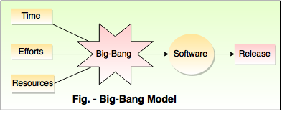
Usage of Big Bang
GRAPHICAL REPRESENTATION
Requirements are not well defined. Even customer is not clear about what he actually want.
It is suitable for small project.
It can be implemented where time limited is not justified.
Development teams are very small.

Slide 18
ADVANTAGE OF BIG BANG MODEL
This is a very simple model
Little or no planning required
Easy to manage
Very few resources required
DISADVANTAGE OF BIG BANG MODEL
Very High risk and uncertainty.
Not a good model for complex and object-oriented projects.
Poor model for long and ongoing projects.
Can turn out to be very expensive if requirements are misunderstood.

Slide 19
AGILE MODEL
It is a combination of iterative and incremental process models with focus on process adaptability and customer satisfaction by rapid delivery of working software product.
Agile Methods break the product into small incremental builds. These builds are provided in iterations.
Iterative approach is applied on each build and working software build is delivered after each iteration.
Each build is incremental in terms of features and the final build holds all the features required by the customer.
The Agile thought process had started early in the software development and started becoming popular with time due to its flexibility and adaptability.

Slide 20
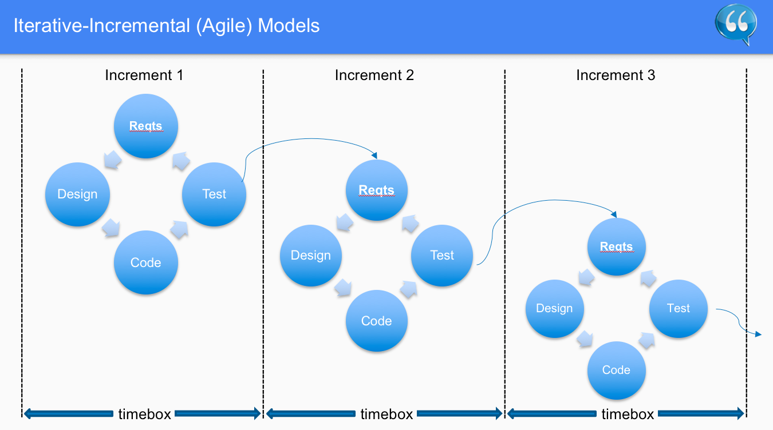
GRAPHICAL REPRESENTATION
SOME IMPORTANT FEATURES
Following are the Agile Manifesto principles −
Individuals and interactions
Working software .
Customer collaboration
Responding to change

Slide 21
ADVANTAGE OF AGILE MODEL
Is a very realistic approach to software development.
Customers are satisfied because of quick and continuous delivery of useful software
Regular delivery of working software
Even the late changes in the requirement can be incorporated in the software
DISADVANTAGE OF AGILE MODEL
Not suitable for handling complex dependencies.
Depends heavily on customer interaction, so if customer is not clear, team can be driven in the wrong direction.
There is a very high individual dependency, since there is minimum documentation generated.
Transfer of technology to new team members may be quite challenging due to lack of documentation.

Slide 22
RAD MODEL
It stands for Rapid Application Development model.
A prototype is a working model that is functionally equivalent to a component of the product.
Rapid Application Development focuses on gathering customer requirements through workshops or focus groups, early testing of the prototypes by the customer using iterative concept.
It is basically a software development methodology that uses minimal planning in favor of rapid prototyping.
It doesn’t need any detailed preplanning, it makes it easier to incorporate the changes within the development process.

Slide 23
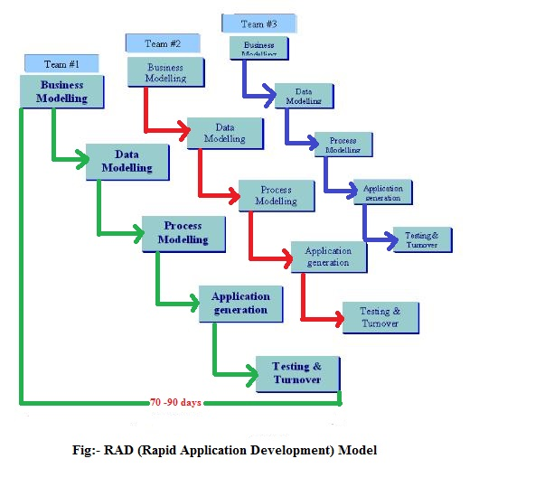
GRAPHICAL REPRESENTATION
WHERE CAN WE USE ?
It should be used if there is a high availability of designers for modeling.
It should be used only if the budget permits use of automated code generating tools.
RAD SDLC model should be chosen only if domain experts are available with relevant business knowledge.
Should be used where the requirements change during the project and working prototypes are to be presented to customer in small iterations of 2-3 months.

Slide 24
ADVANTAGE OF RAD MODEL
Changing requirements can be accommodated.
It is helpful when you have to reduce the overall project risk.
Reduced development time and Increases reusability of component.
Encourages customer feedback.
DISADVANTAGE OF RAD MODEL
Cant be use for smaller projects.
When technical risk is high, it is not suitable.
Requires highly skilled designers or developers.
Requires user involvement throughout the life cycle.

Slide 25
SOFTWARE PROTOTYPE MODEL
In this model we are designing software application prototypes which displays the functionality of the product under development
The prototype of application may or may not actually hold the exact logic of the original software.
Software prototyping is popular because it enables to understand customer requirements at an early stage of development.
It helps get valuable feedback from the customer and helps software designers and developers understand about what exactly is expected from the product under development.
It also allows the users evaluate developer proposals and try them out before implementation.

Slide 26
DESIGN OF PROTOTYPING
Basic Requirement Identification
Developing the initial Prototype
Review of the Prototype
Revise and Enhance the Prototype
TYPES OF SOFTWARE PROTOTYPE
Throwaway/Rapid Prototyping
Evolutionary Prototyping
Incremental Prototyping
Extreme Prototyping

Slide 27
ADVANTAGE OF SOFTWARE PROTOTYPE
Increased user involvement in the product even before its implementation.
Since a working model of the system is displayed, the users get a better understanding of the system being developed.
Reduces time and cost as the defects can be detected much earlier.
Quicker user feedback is available leading to better solutions.
DISADVANTAGE OF SOFTWARE PROTOTYPE
Risk of insufficient requirement analysis owing to too much dependency on the prototype.
Users may get confused in the prototypes and actual systems.
Developers may try to reuse the existing prototypes to build the actual system, even when it is not technically feasible.
The effort invested in building prototypes may be too much if it is not monitored properly.

Slide 28
CONCLUSION
So far we have discussed the different approaches for Software Development LifeCycle.
They have there own advantages and disadvantages.
One can select appropriate type of SDLC based on developer and customers requirement.
These days most frequent SDLC model used by software industry is the Agile Model.
The approach used by Agile mode (i.e. divide and develop the software) is so favorable.
This model provide traceability to the software.

